Slide 1


UNIVERSITY INSTITUTE OF ENGINEERING
COMPUTER SCIENCE & ENGINEERING
Introduction to Information Security and Cryptography
(Subject Code:20CST-354/ITT-354)
Prepared By : Er. Puneet kaur(E6913)
INTRODUCTION
DISCOVER . LEARN . EMPOWER

Slide 2

Schnorr Digital Signature
www. cuchd.in Campus : Gharaun, Mohali

Slide 3
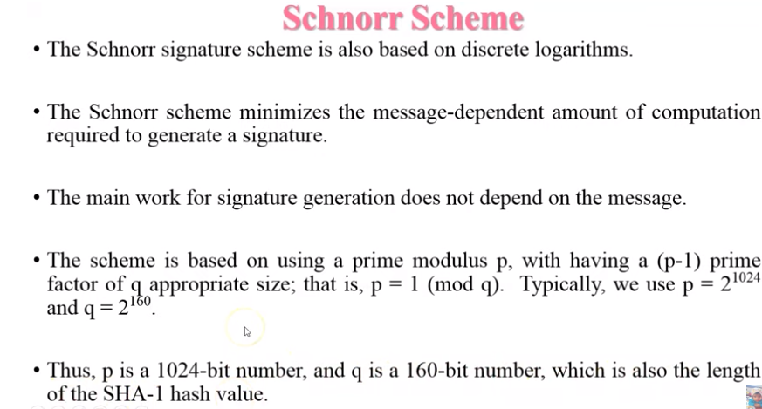

Slide 4
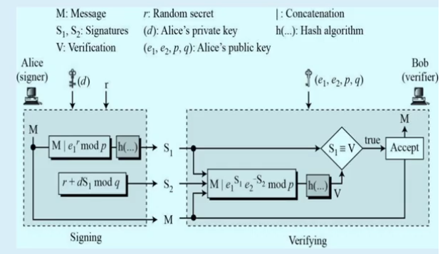

Slide 5
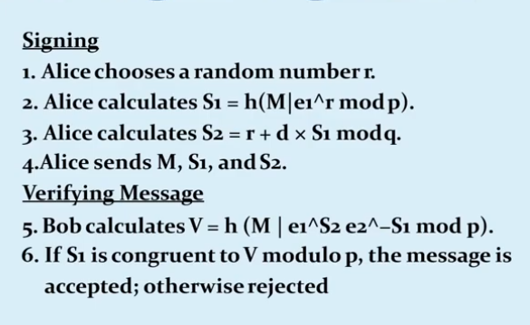

Slide 6
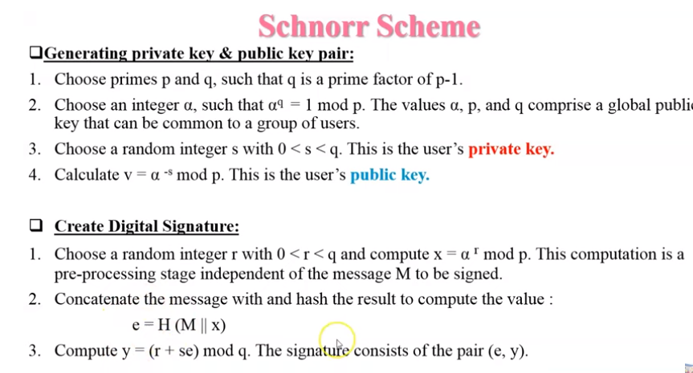

Slide 7
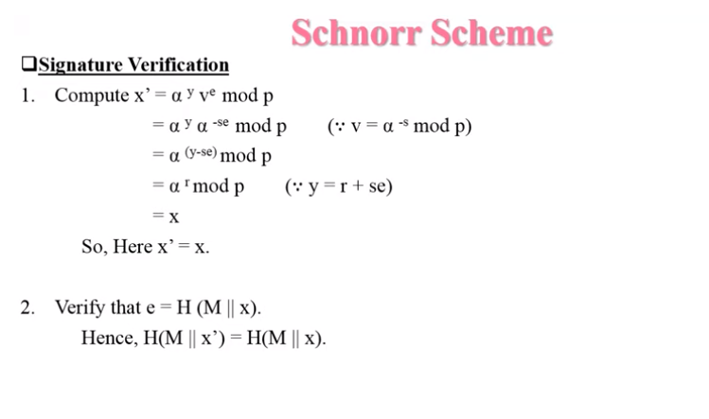

Slide 8
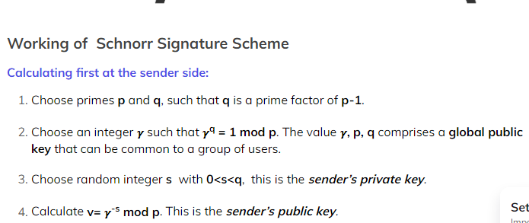

Slide 9
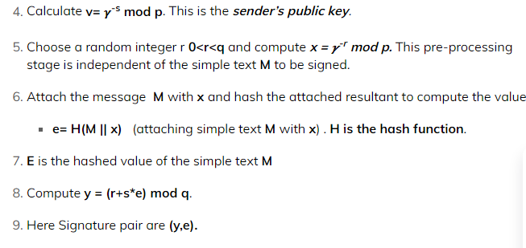

Slide 10
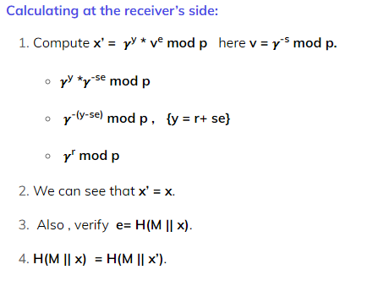

Slide 11
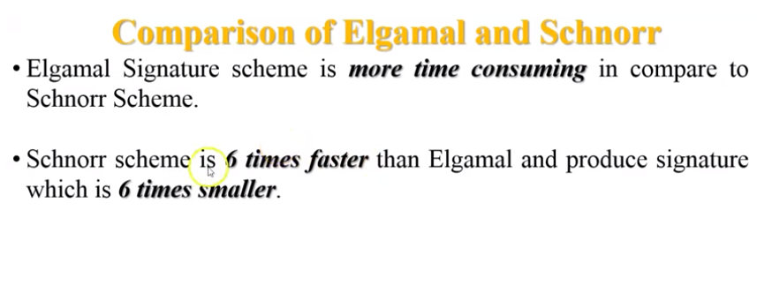

Slide 12
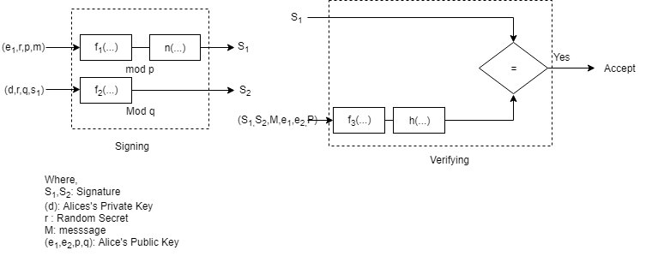
Schnorr Digital Signature

Slide 13
Schnorr Digital Signature
Where, S1,S2S1,S2: signatures
D: alices private key
R: random secret
M: message

Slide 14
Schnorr Digital Signature
(e1,e2,p,qe1,e2,p,q): Alices public key
In signing process, two functions create two signatures, in the verifying process the output of one function is compared to the 1st signature for verification.
Here two modules: p & q are used
Function 1 & 3 use p,
Function 2 uses q

Slide 15
Key generation:
Before signing a message, Alice needs to generate keys and announce the public keys to the public.
a. Alice selects a prime ‘P’ which is usually 1024 bits in length
b. Alice selects another prime of which is the same size as the digest created by the cryptographic hash function (currently 160 b) but it may change in the future. The prime q needs to divide (p-1) i.e (p-1)= 0 mod q
c. Alice chooses e1e1 to be the qth root of 1 module p, for the alice chooses a primitive element e0e0 and calculate e1=e(p−1)/q0modpe1=e0(p−1)/qmodp

Slide 16
Key generation:
d. Alice chooses an integer, d as her private key
e. Alice calculate e2=ed1modpe2=e1dmodp
f. Alice’s public key is (e1,e2,p,q)(e1,e2,p,q); & private key is d.

Slide 17
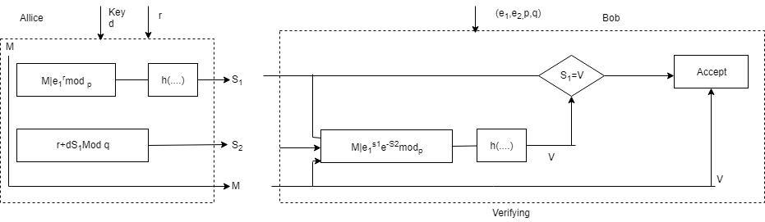
Key generation:

Slide 18
Key generation:
Where,
M: message, r: Random secret, I: concatenation
S1,S2S1,S2: Signature, d: Alice’s Private key, n(…) hash algorithm.
V: verification (e1,e2,p,q)(e1,e2,p,q) : Alices public key

Slide 19
Signing:
Alice chooses a random number r. note that although public & private keys can be used to sign multiple messages, Alice needs to change and each time she sends a new message. Note also that and needs to be between 1 and q
Alice calculates the first signature S1=h(M|eR1modp)S1=h(M|e1Rmodp). The message is prepended to the value of eR1modpe1Rmodp; then the hash function is applied to create a digest. Net that the hash function is not directly applied to the message, but instead is applied to the concatenation of M and eR1modpe1Rmodp
Alice calculates the second

Slide 20
Signing:
Alice calculates the second signature S2=r+dXS1modqS2=r+dXS1modq. Note that part of the calculation of S2S2 is done in module q arithmetic.
Alice sends M, S1S1 & S2S2

Slide 21
Verifying Message
The receiver Bob, assume receives M, S1 and S2
Bob calculates V= h(M|eS21e−S12modp)e1S2e2−S1modp)
if S1S1 is congruent to V modulo p, the message is accepted other rejected.

Slide 22
References
http://www.brainkart.com/article/Classical-Encryption-Techniques_8339/
https://www.tutorialspoint.com/cryptography/index.htm
https://www.geeksforgeeks.org/cryptography-introduction/
https://www.techopedia.com/definition/1770/cryptography#:~:text=Cryptography%20involves%20creating%20written%20or,information%20to%20be%20kept%20secret.&text=Information%20security%20uses%20cryptography%20on,transit%20and%20while%20being%20stored.
https://www2.slideshare.net/lineking/classical-encryption-techniques-in-network-security?qid=e388c29f-793d-4f2b-bcaf-9d22e9ca07b5&v=&b=&from_search=1

Slide 23
E- Books Recommended
https://www.pdfdrive.com/cyber-security-books.html
https://bookauthority.org/books/new-cyber-security-ebooks
https://bookauthority.org/books/best-cyber-security-ebooks
https://www.freetechbooks.com/information-security-f52.html

